Slide 1

ASP.NET Core Identity
Implementing login/logout, Scaffolding
SoftUni Team
Technical Trainers
Software University
https://softuni.bg

Slide 2
Have a Question?
sli.do #csharp-web

Slide 3
Table of Contents
Authentication vs. Authorization
ASP.NET Core Identity
Scaffolding Identity
IdentityUser

Slide 4

Authentication vs. Authorization

Slide 5
Authentication vs. Authorization
Authentication
The process of verifying the identity of a user or computer
Prerequisite for authorization
Questions: Who are you? How you prove it?
Credentials can be password, smart card, external token, etc.
Authorization
The process of determining what a user is permitted to do on a computer or network
Questions: What are you allowed to do? Can you see this page?
You can't authorize a user before authenticating this user

Slide 6
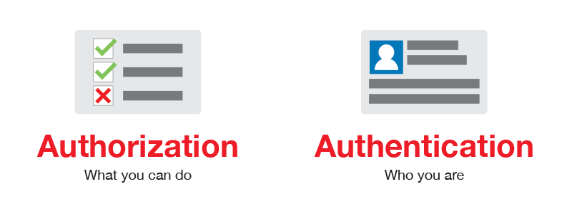
Authentication vs. Authorization

Slide 7

ASP.NET Core Identity

Slide 8
ASP.NET Core Identity
The ASP.NET Core Identity system
Authentication and authorization system for ASP.NET Core
Supports ASP.NET Core MVC, Pages, Web API (JWT), SignalR
Handles Users, User Profiles, Login / Logout, Roles, etc.
Handles cookie consent and GDPR
Supports external login providers
Facebook, Google, Twitter, etc.
Supports database, Azure, Active Directory, Windows Users, etc.

Slide 9

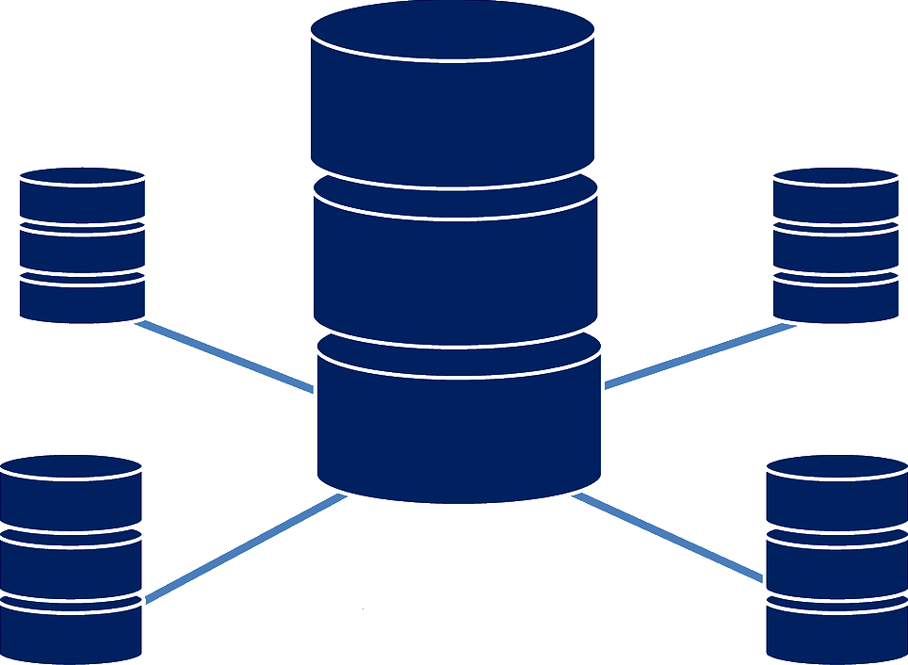
ASP.NET Core Identity
Typically, the ASP.NET Core identity data is stored in relational database
Data is persisted using Entity Framework Core
You have some control over the internal database schema

Slide 10
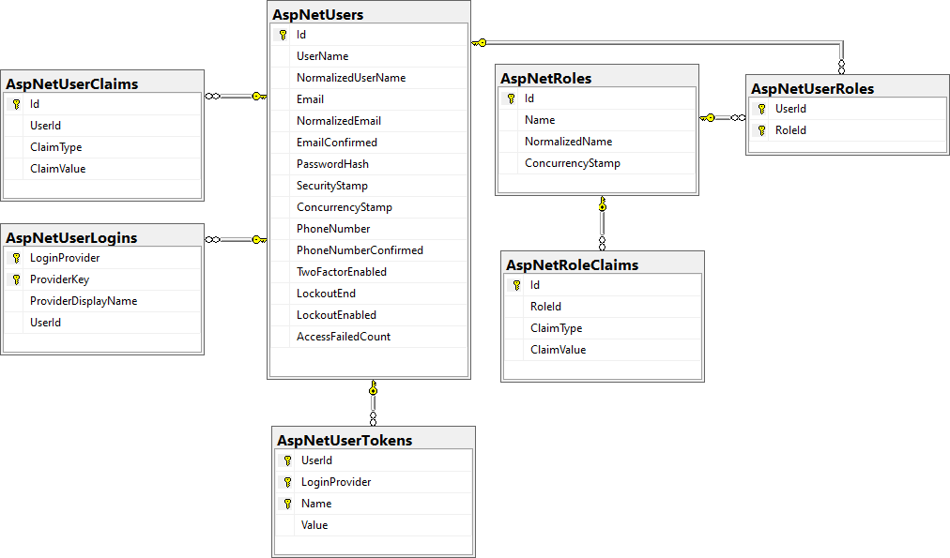
Internal Database Schema

Slide 11

ASP.NET Core Identity System Setup
Setup ASP.NET Identity
Using the ASP.NET project templates from Visual Studio
And then customize it
By hand
Install NuGet packages, manual configuration, create EF mappings (models), view models, controllers, views, etc.
Required NuGet package
Microsoft.AspNetCore.Identity.EntityFrameworkCore

Slide 12
ASP.NET Core Project Template Authentication
ApplicationDbContext.cs
Holds the EF data context
Provides access to the application's data using model objects
Program.cs
Can configure cookie-based (or JWT) authentication
May enable external login (e.g., Facebook login)
Can change default identity settings
More on those in the next course

Slide 13


ASP.NET Core Project Template Authentication
Password settings – can be defined in Program.cs
builder.Services.AddDefaultIdentity<IdentityUser>(options =>
{
// Password, lockout, emails, etc.
options.SignIn.RequireConfirmedAccount = false;
options.Password.RequireDigit = false;
})
.AddEntityFrameworkStores<ApplicationDbContext>();

Slide 14

Scaffolding Identity

Slide 15
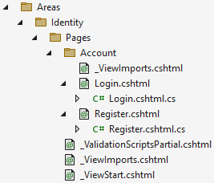
Scaffolding ASP.NET Core Identity
Since ASP.NET Core 2.2, Identity is provided as a Razor Class Library
The scaffolder can be configured to generate source code
If you need to modify the code and change the behavior
Most of the necessary code is generated by the scaffolder
Scaffolded Account.Register and Account.Login

Slide 16
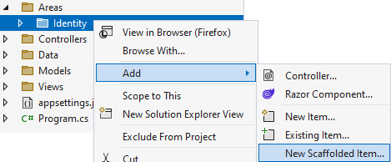
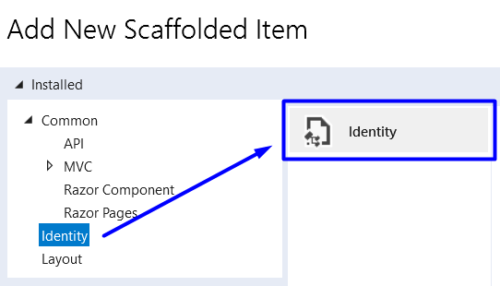
Scaffolding ASP.NET Core Identity in VS
Scaffold Identity pages by adding a new scaffolded identity item

Slide 17
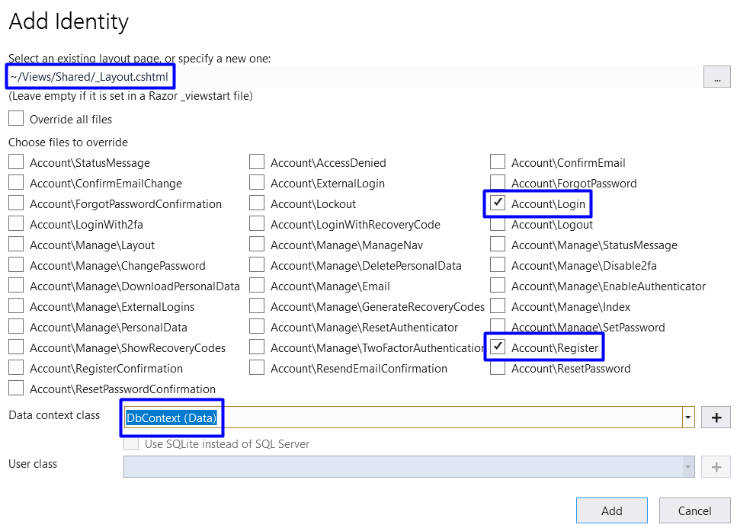
Scaffolding ASP.NET Core Identity in VS
Scaffolded pages will be part of the "/Areas/Identity" folder
Select pages to be scaffolded
Select the layout page
Select pages to be scaffolded
Select the db context

Slide 18

IdentityUser

Slide 19
ASP.NET Core User Manager
UserManager<TUser> - APIs for managing users in a persistence store
AddClaimAsync(…) | DeleteAsync(…)
AddPasswordAsync(…) | FindByIdAsync(…)
AddToRoleAsync(…) | FindByNameAsync(…)
AddToRolesAsync(…) | GetClaimsAsync(…)
ChangeEmailAsync(…) | GetRolesAsync(…)
ChangePasswordAsync(…) | GetUserAsync(…)
CheckPasswordAsync(…) | GetUserIdAsync(…)
ConfirmEmailAsync(…) | RemoveClaimAsync(…)
CreateAsync(…) | ValidateUserAsync(…)

Slide 20
ASP.NET Core SignIn Manager
SignInManager<TUser> – APIs for user sign in
AddClaimsAsync(…) | FindByEmailAsync(…) | GenerateChangePhoneNumberTokenAsync(…)
AddToRoleAsync(…) | FindByIdAsync(…) | GenerateEmailConfirmationTokenAsync(…)
IsInRoleAsync(…) | FindByNameAsync(…) | GeneratePasswordResetTokenAsync(…)
GetUserId(…) | GetClaimsAsync(…) | GetAuthenticationTokenAsync(…)
ChangeEmailAsync(…) | GetEmailAsync(…) | IsEmailConfirmedAsync(…)
ConfirmEmailAsync(…) | GetRolesAsync(…) | CreateSecurityTokenAsync(…)
CreateAsync(…) | GetUserAsync(…) | ResetPasswordAsync(…)
DeleteAsync(…) | CheckPasswordAsync(…) | RemoveFromRoleAsync(…)
Dispose(…) | UpdatePassword(…) | RemoveClaimsAsync(…)

Slide 21
Register
public async Task<IActionResult> Register()
{
var user = CreateUser();
var result = await _userManager.CreateAsync(user, "S0m3@Pa$$");
if (result.Succeeded)
// User registered successfuly
}
private IdentityUser CreateUser()
{
try
{
return Activator.CreateInstance<IdentityUser>();
}
// catch exception if not successful
}

Slide 22
Login
public async Task<IActionResult> Login()
{
bool rememberMe = true;
bool shouldLockout = false;
var signInStatus = await _signInManager.PasswordSignInAsync(
"John", "S0m3@Pa$$", rememberMe, shouldLockout);
if (signInStatus.Succeeded)
{
// Sucessful login
}
else
{
// Login failed
}
}

Slide 23

Logout
public async Task<IActionResult Logout()
{
await _signInManager.SignOutAsync();
}

Slide 24
Check the Currently Logged-In User
// GET: /Account/Roles (for logged-in users only)
[Authorize]
public ActionResult Roles()
{
var currentUser = await userManager.GetUserAsync(this.User);
var roles = await userManager.GetRolesAsync(currentUser);
...
}
// GET: /Account/Data (for logged-in users only)
[Authorize]
public ActionResult Data()
{
var currentUser = await userManager.GetUserAsync(this.User);
var currentUserUsername = await userManager.GetUserNameAsync(currentUser);
var currentUserId = await userManager.GetUserIdAsync(currentUser); ...
}

Slide 25
Authorization
Use the [Authorize] and [AllowAnonymous] attributes to configure Authorized / Anonymous access for Controller / Action
[Authorize]
public class AccountController : Controller
{
// GET: /Account/Login (anonymous)
[AllowAnonymous]
public async Task<IActionResult> Login(string returnUrl) { … }
// POST: /Account/LogOff (for logged-in users only)
[HttpPost]
public async Task<IActionResult> Logout() { … }
}

Slide 26

Summary
…
…
…
Authentication vs. Authorization
ASP.NET Core Identity
Scaffolding Identity
IdentityUser

Slide 27









Questions?

Slide 28










SoftUni Diamond Partners

Slide 29
Trainings @ Software University (SoftUni)
Software University – High-Quality Education, Profession and Job for Software Developers
softuni.bg, about.softuni.bg
Software University Foundation
softuni.foundation
Software University @ Facebook
facebook.com/SoftwareUniversity
Software University Forums
forum.softuni.bg
29
Notes:
29

Slide 30

License
This course (slides, examples, demos, exercises, homework, documents, videos and other assets) is copyrighted content
Unauthorized copy, reproduction or use is illegal
© SoftUni – https://about.softuni.bg
© Software University – https://softuni.bg
Notes:
30

